Slide 1
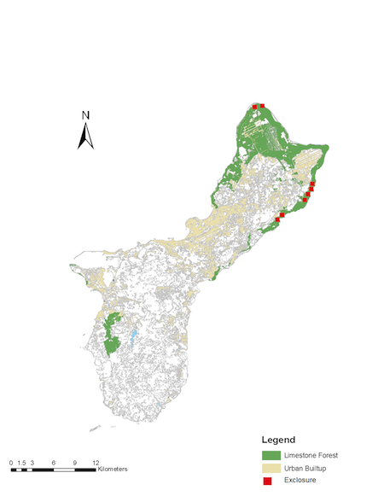
Legend
Limestone Forest
Urban
Exclosure
Transect

